Slide 1
Antibody Staining

Slide 3
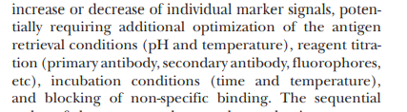
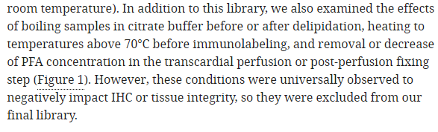
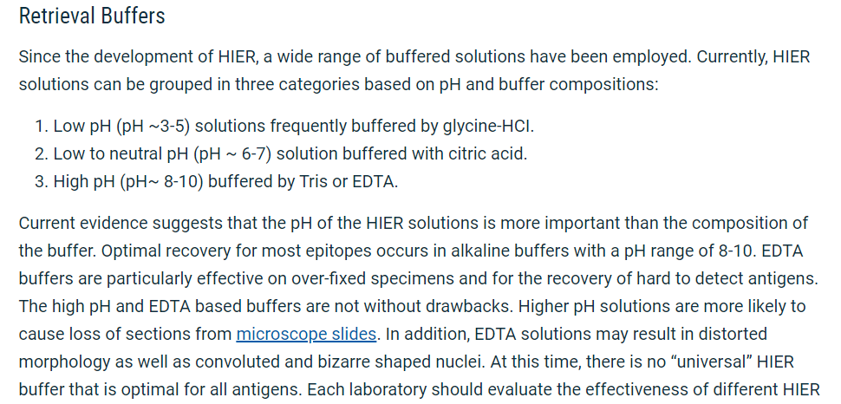
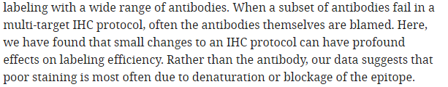
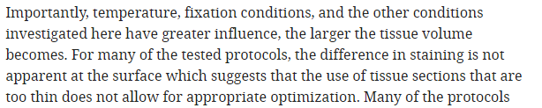
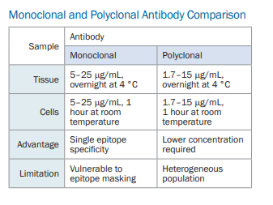
Key Take Aways

Slide 4
Parameters
Idea is to vary parameters. What are relevant things?
Looking at Doug’s paper, it appears to be much easier to stain thin samples. Things like heat, glycine, glycerol, etc. don’t seem to play a massive role, although some completely block it out.
Most likely antigen retrieval methods and blocking buffer choices will play the biggest roles.
Come up with 3-4 different conditions and the antibody works or doesn’t in them
Below is a list of possible parameters to vary

Slide 5
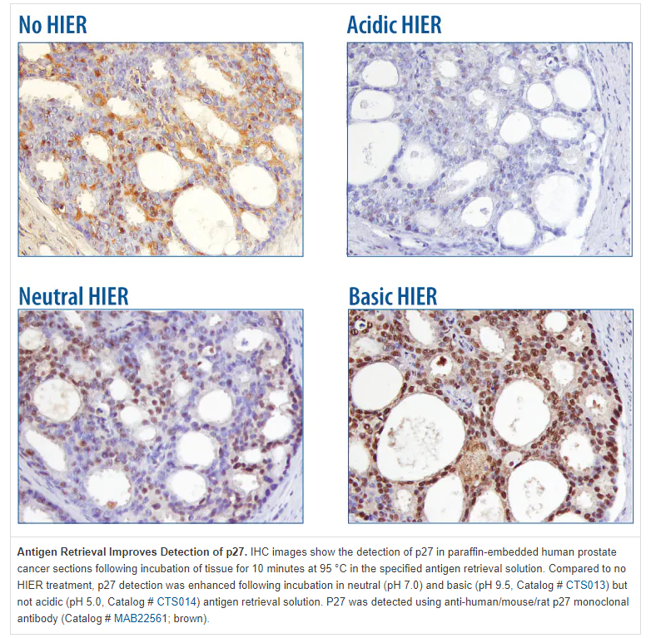

Slide 6
